Slide 1


NALAYATHIRAN
TEAM NAME : Free Thinkers
TEAM ID: PNT2022TMID49457

Slide 2
PROBLEM STATEMENT
Fertilizer recommended system for disease prediction
Agriculture is the main aspect of country development. Many people lead their life from agriculture field, which gives fully related to agricultural products. Plant disease, especially on leaves, is one of the major factors of reductions in both quality and quantity of the food crops. In agricultural aspects, if the plant is affected by leaf disease then it reduces the growth of the agricultural level.

Slide 3
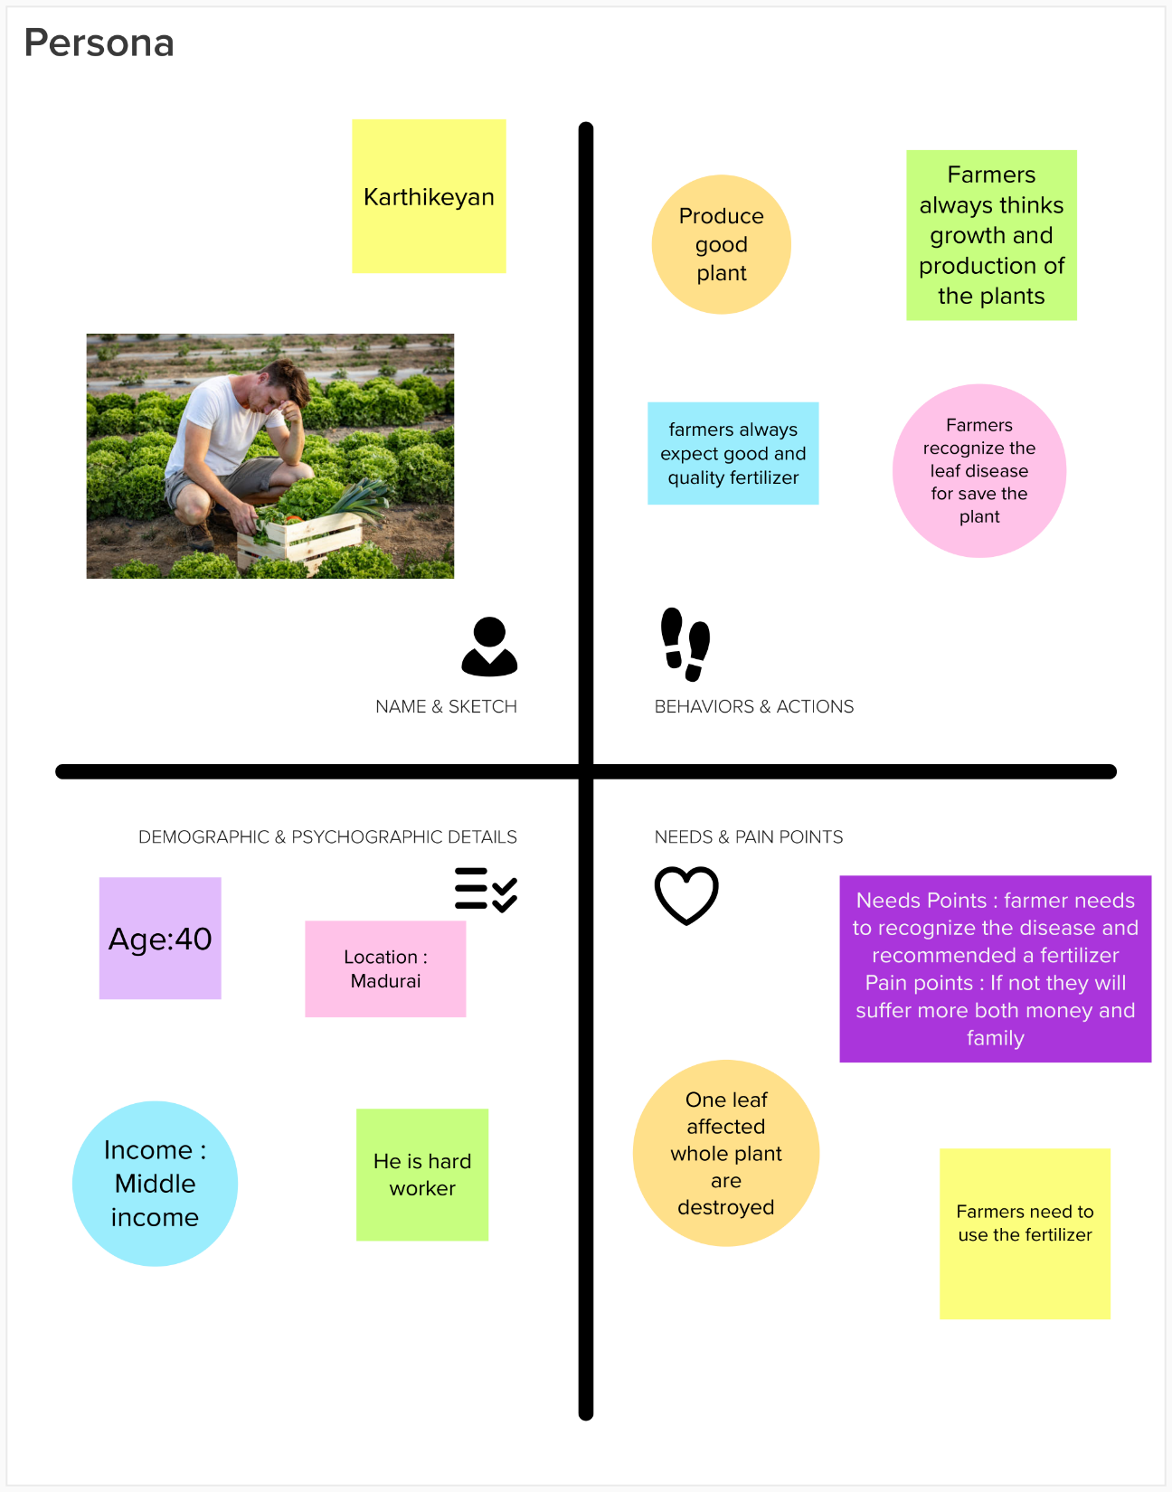
Persona & Context(Empathy map)

Slide 4
TEAM LEAD
Ishwarya R (923819104014)
TEAM MEMBERS
Anish Fathima M (923819104004)
Emili S (923819104011)
Lakshmipriya S (923819104023)
Priyadharshini A (923819104034)

Slide 5
THANK YOU

